Slide 1
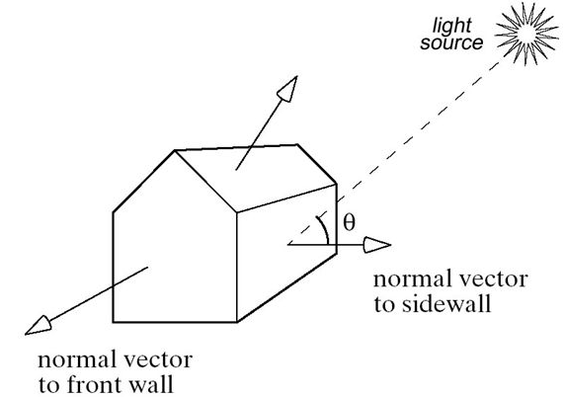
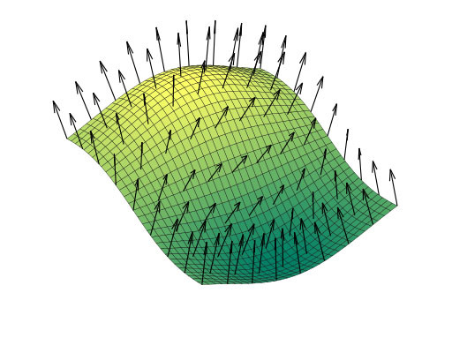
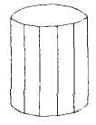
3D Object Representation

Slide 2
3D Object Representation
Graphics scenes can contain trees, flowers , clouds rocks water, rubber, paper , bricks etc.
Polygon and quadratic surfaces provide precise descriptions for simple Euclidean objects such as polyhedrons ellipsoid.
Polygon Surfaces
3-D graphics object is a set of surface polygons that enclose the object interior
A polygon mesh is a set of connected polygonally bounded planar surfaces
Equation of plane is Ax + By + Cz + D = 0
A polygon mesh is a collection of edges, vertices and polygons connected such that each edge is shared by at most two polygons.

Slide 3
Polygon Tables
Polygon data tables can be organized into two groups:
geometrical table
attribute table
Geometric Data Tables
- contain vertex coordinates and parameters to identify the spatial orientation of polygon surfaces
Attribute Table
- includes parameters specifying the degree of transparency of object and its surface reflectivity and texture characteristics.

Slide 4
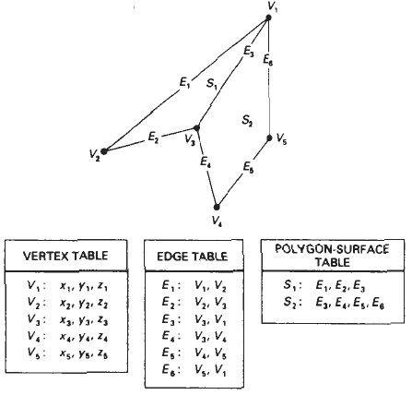
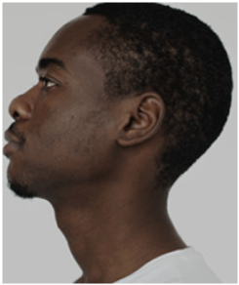
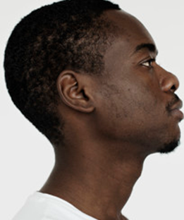
3D Object Representation
A convenient organization for storing geometric data is to create three lists:
i. a vertex table
ii. an edge table
iii. a polygon table

Slide 5
Plane Equations
The equation for a plane surface can be expressed as
Ax + By + Cz + D =0 …….(i)
where, (x,y,z) is any point on the plane
Coefficients ABCD are constants describing spatial properties of plane
For solving ABCD consider three successive polygon vertices (x₁, y₁, z₁), (x₂, y₂, z₂), (x₃, y₃, z₃)
So equation (i) is modified to,
A x_{k} + B y_{k} + C z_{k} = -1 …….(ii) k = 1,2,3
D D D

Slide 6
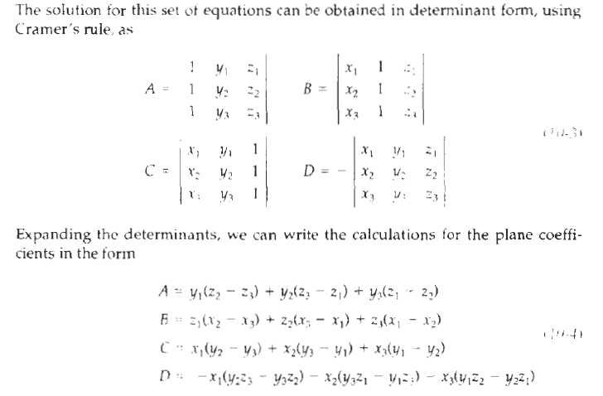
Plane Equations
For solving ABCD consider three successive polygon vertices
(x₁, y₁, z₁), (x₂, y₂, z₂), (x₃, y₃, z₃)
So equation (i) is modified to,
A x_{k} + B y_{k} + C z_{k} = -1 …….(ii) k = 1,2,3
D D D
As vertex values and other information are entered into the polygon data structure,
values tor A, 8, C'. and D are computed for each polygon and stored with the other polygon data.

Slide 7
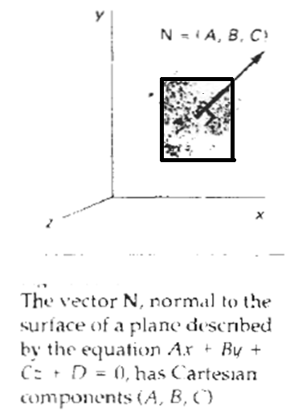
Plane Equations
Orientation of a plane surface in space can be described with the normal
vector to the plane
This surface normal vector has Cartesian components (A, B, C), where parameters A, B, and C are the plane coefficients (describing spatial properties of plane) calculated

Slide 8
3D Object Representation
Plane equations are used to identify the position of spatial points relative to the plane surfaces of an object. For any point (x,y,z) not on plane with parameters ABCD we have
Ax + By + Cz + D = 0
We can identify the point as either inside or outside the plane surface according to the sign( + or -) of
Ax + By + Cz + D
If Ax + By + Cz + D < 0 then the point (x,y,z) is inside the surface
If Ax + By + Cz + D > 0 then the point (x,y,z) is outside the surface

Slide 9
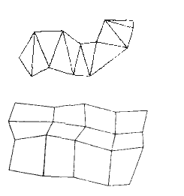
Polygon Meshes
Some graphics packages (PHIGS programmer’s Hierarchical Interactive Graphics Standard) provide several polygon functions for modeling objects.
One type of polygon mesh is the triangle strip
It produces n – 2 connected triangles, given the coordinates for n vertices.
Another similar functions the quadrilateral mesh that generates a mesh of (n-1)(m-1) quadrilaterals, given the coordinates for an n by m array of vertices

Slide 10

Hidden Surface Removal (Visible Surface Detection)
Screen
FrameBuffer

Slide 11
Hidden Surface Removal

Slide 12
Hidden Surface Removal (Visible Surface Detection)
Major concern for realistic graphics is identifying those pars of a scene that are visible from a chosen viewing position
Object Space Methods ( OSM )
- OSM compares objects and parts of object to each other within the scene definition to determine which surfaces as a whole we should label as visible e.g. Back Face Detection method
Image Space Method ( ISM )
- ISM decides point by point at each pixel position and is most widely used.

Slide 13
Hidden Surface Removal (Visible Surface Detection)
Object Space Methods ( OSM )
- Back Face Detection method
Image Space Method ( ISM )
Z Buffer
A Buffer
Scanline
Hybrid (Image/Object)
- Depth Sorting
Area Subdivision Method

Slide 14
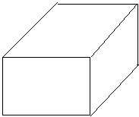
Backface Detection
V , a view vector is constructed from any point on the surface to the viewpoint, the dot product of this vector and the normal n, indicates visible faces as follows:
If v.n > 0 the face is visible else face is hidden
I vector directed to a point inside object
n
n
v

Slide 15
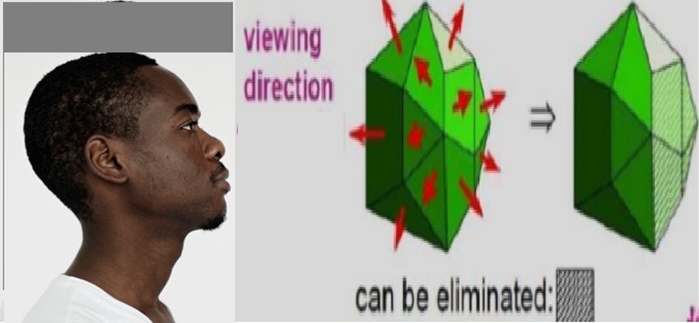
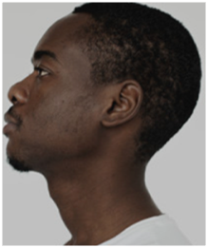
Backface Detection

Slide 16
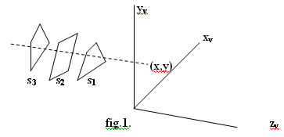
Z-buffer or Depth buffer Method:
Commonly used ISM
Since object depth is usually measured from the view plane along the z axis of a viewing surface, each surface of a scene is processed separately , one point at a time across the surface
Usually for polygon surface, because depth values can be computed very quickly and the method is easy to implement and can apply to non planar surfaces.
Implementing the algorithm in normalized coordinates , z value ranges from 0 at the back clipping plane to z_{max} at the front clipping plane.
R G B

Slide 17
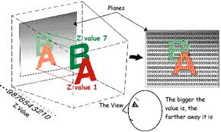
Z-buffer or Depth buffer Method:

Slide 18
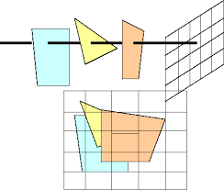
Z-buffer or Depth buffer Method:

Slide 19
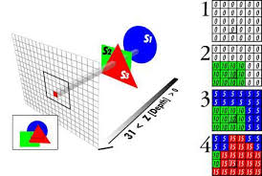
Z-buffer or Depth buffer Method:

Slide 20
Z-buffer or Depth buffer Method:
Algorithm:
Initialize the depth buffer and refresh buffer so that for all buffer
position (x,y)
depth(x,y) = 0 or (zmin) and refresh(x,y) = Ibackground
ii. For each position on each polygon surface compare depth values to
previously stored values in the depth buffer to determine visibility
Calculate the depth ‘z’ for each (x,y) position on the polygon
iii. If z > depth(x,y) then set
depth = z and refresh(x,y) = Isurface (x,y)
where Ibackground (x,y) is background intensity , Isurface (x,y) is projected intensity value for surface at pixel position (x,y)

Slide 21
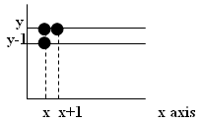
Hidden Surface Removal (Visible Surface Detection)
After all surfaces have been processed the depth buffer contains depth values for the visible surfaces and the refresh buffer contains the corresponding intensity values for those surfaces
  Depth value for a surface position (x, y) is
  z = (-Ax –By – D)/c …………………(i)
  Let depth z’ at (x + 1 , y)
  z’ = -A(x+1) – By – D/c or z’ = z – A/c………..(ii)

Slide 22
Hidden Surface Removal (Visible Surface Detection)
Now since (-A/c) is constant for each surface, so succeeding depth values across a scan-line are obtained from preceding values with a simple mathematics.
On each scan-line , we start by calculating depth on a left edge of the polygon that intersect that scan-line (fig ii) ‘z’ at each successive position across the scan line are the calculated by equation z’ = -A(x+1) – By – D/c or z’ = z – A/c………..(ii)

Slide 23
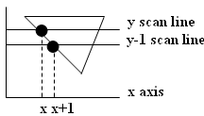
Hidden Surface Removal (Visible Surface Detection)
first determine y coordinate extents of each polygon y scan line and process from top scan to bottom scan starting y-1 scan line at a top vertices we can recursively calculate ‘x’ position
down a left edge of the polygon as
x’ = x - 1/ m where m is the slope of edge fig (iii)
‘z’ values down the edge are then obtained recursively as figure.
z’ = z + (a/m + b) /c or z’ = z + b/c as m → for vertical edge

Slide 24
A Buffer Method
An extension of the ideas in the depth-buffer method
It represents an antialiased, area-averaged, accumulation-buffer method developed by Lucasfilm for implementation in the surface-rendering system called REYES ("Renders Everything You Ever Saw").
A drawback of the depth-buffer method
- deals only with opaque surfaces and cannot accumulate intensity values for more than one surface, as is necessary if transparent surfaces are to be displayed.
The A-buffer method expands the depth buffer
- each position in the buffer can reference a linked list of surfaces.
- more than one surface intensity can be taken into consideration at each pixel position, and object edges can be antialiased.

Slide 25
A Buffer Method
Each position in the A-buffer has two fields:
i) depth field - stores a positive or negative real number
ii) intensity field - stores surface-intensity information or a pointer value.
Depth field is positive:
Number stored at that position is the depth of a single surface overlapping the corresponding pixel area.
Intensity field then stores the RCB components of the surface color at that point and the percent of pixel coverage.
Depth field is negative:
Indicates multiple-surface contributions to the pixel intensity.
Intensity field then stores a pointer to a linked list of surface data

Slide 26
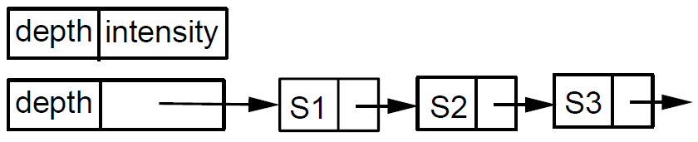
A Buffer Method
Data for each surface in the linked list includes:
- RGB intensity components
- opacity parameter (percent of transparency)
- depth
- percent of area coverage
- surface identifier
- other surface-rendering parameters
- pointer to next surface
o = 10% o = 10% o = 80%
R G B

Slide 27
A Buffer Method
The A-buffer can be constructed using methods similar to those in the depth-buffer algorithm.
Scan lines are processed to determine surface overlaps of pixels across the individual scanlines.
Surfaces are subdivided into a polygon mesh and clipped against the pixel boundaries.
Using the opacity factors and percent of surface overlaps, we can calculate the intensity of each pixel as an average of the contributions from the overlapping surfaces.

Slide 28
Scan-line Method
ISM for removing hidden surfaces is an extension of the scan-line algorithm for filling polygon interiors.
Instead of filling just one surface we consider multiple surfaces.
As each scan-line is processed all polygon surfaces intersecting that line are examined to determine which are visible
We assume that tables (polygon) are set up for the various surfaces (edge, polygon etc)

Slide 29
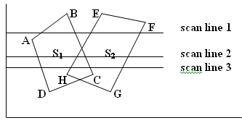
Scan-line Method
Polygon table contains coefficients of the plane equation for each surface intensity information for the surfaces and possible pointers into the edge table
Active edge list for scan-line1 contains scan line 1 information from the edge table for edges AB,BC,EH, FG

Slide 30
Scan-line Method
Scan-line 1 edges AB and BC
Only the flags for surfaces S₁ is on
No depth calculation is necessary
Intensity information for surface S₁ is entered from the polygon table into the refresh buffer
Between edges EH and FG only the flag for surface S₂ is on.
No other position along scan-line1 intersect surfaces so intensity values in the other areas are set to
background intensity
For scan-line 2 and 3 the active edge list contains edges AD, EH, BC and FG
Along scan-line2 from edge AD to edge EH only the flag for surface S₁ is on.
But between edges EH and BC the flags for both surfaces are on and depth calculations must be made using
plane coefficients for the two surfaces,
e.g if ‘z’ of surface S₁ is less than that of S₂ intensities for surface S₁ are loaded into the refresh buffer until
boundary BC is encountered.
Then the flag for surface S₁ goes off and intensities for surface S₂ are stored until edge FG is passed
Any number of overlapping polygon surfaces can be processed with this scan-line method.

Slide 31
Scan-line Method
Scan line 1 (edges EH and FG)
Only the flag for surface S₂ is on
No other position along scan-line1 intersect surfaces so intensity values in the other areas are set to background intensity
For scan-line 2 and 3 the active edge list contains edges AD, EH, BC,FG
Along scan-line2 from edge AD to edge EH only the flag for surface S₁ is on.
But between edges EH and BC the flags for both surfaces are on and depth calculations must be made using
plane coefficients for the two surfaces,
e.g if ‘z’ of surface S₁ is less than that of S₂ intensities for surface S₁ are loaded into the refresh buffer until
boundary BC is encountered.
Then the flag for surface S₁ goes off and intensities for surface S₂ are stored until edge FG is passed
Any number of overlapping polygon surfaces can be processed with this scan-line method.

Slide 32
Scan-line Method
Scan-line 2 (active edge list contains edges AD, EH, BC and FG)
From edge AD to edge EH
Only the flag for surface S₁ is on
From edge EH and BC
Flags for both surfaces (S₁ ,S₂) are on and depth calculations must be made using plane coefficients for the two surfaces,
e.g if ‘z’ of surface S₁ is less than that of S₂ intensities for surface S₁ are loaded into the refresh buffer until
boundary BC is encountered.
Then the flag for surface S₁ goes off and intensities for surface S₂ are stored until edge FG is passed
Any number of overlapping polygon surfaces can be processed with this scan-line method.

Slide 33
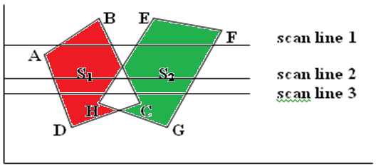
Scan-line Method
if ‘z’ of surface S₁ is less than that of S₂
Intensities for surface S₁ are loaded into the refresh buffer until boundary BC is encountered.
Then the flag for surface S₁ goes off and intensities for surface S₂ are stored until edge FG is passed
Any number of overlapping polygon surfaces can be processed with this scan-line method.

Slide 34
List Priority Algorithms
Determines a visibility ordering for objects ensures that a correct picture results if objects are rendered in that order.
e.g. if no object overlaps in ‘z’ then we need only to sort objects by increasing ‘z’ and render them in that order.
Farther objects are obscured by closer ones as pixels from the closer polygons overwrite those of more distant ones.
If objects overlap in ‘z’, we may still be able to determine a correct order.
If objects cyclically overlap, or penetrate each other, then there is no correct order.

Slide 35
List Priority Algorithms
Hybrids that combine both object and image precision operations.
Depth comparison and object splitting are done with object precision.
Scan conversion (which relies on ability of graphics device to overwrite pixels of previously drawn objects) is done with image precision.

Slide 36
Depth sorting Method
Makes use of both image and object space operations to:
i. Sort surfaces in decreasing depth order (using both image and object
space)
ii. Scan converted in order starting with surface with greatest depth (using
image space)
Also referred to as painters algorithm because an artist first paints background color then most distant object then nearer object and so on.
In the end the foreground objects are painted on canvas over the background. Each layer of paint covers up previous layer

Slide 37
Depth sorting Method
Approach:
First sort surfaces according to their distance from view plane.
Intensity values for farthest surface are entered into refresh buffer.
Taking each surface in turn (in decreasing depth order) paint surface intensities onto frame buffer over intensity of previously processed surface

Slide 38
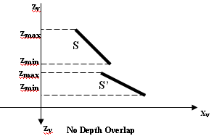
Depth sorting Method
Assume we’re viewing along ‘z’ direction.
Surfaces zmax are ordered according to largest ‘z’ value on each surface zmin
Surface with greatest depth is compared with other zmax surface in list to see if there are any overlaps in depth zmin
If no depth overlap then surface S is scan converted

Slide 39
B. Depth sorting Method
Additional test are required for each surface in case of depth overlap with surface S:
i. Bounding rectangle in xy plane for two surfaces don’t overlap
ii. Surface S is completely behind overlapping surface relative to viewing
position
iii. Overlapping surface S’ is completely in-front of S relative to viewing
position
iv. Projection of 2 surfaces onto view plane don’t overlap.
If any of these conditions is true then no reordering of surfaces is necessary. i.e. if all surfaces pass at least one of the tests then none of those surfaces are behind S.

Slide 40
Depth sorting Method
Similarly, we first sort surfaces according to their distance from view plane.
Intensity values for farthest surface are entered into refresh buffer.
Taking each surface in turn (in decreasing depth order) we paint surface intensities onto frame buffer over intensity of previously processed surface

Slide 41
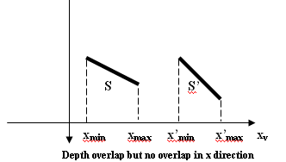
Depth sorting Method
For test ( i)
Perform two steps to check overlap first in ‘x’ then in ‘y’ direction.
If either of these directions show no overlap S is completely behind then the two planes cannot obscure one another.

Slide 42
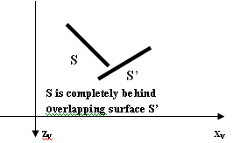
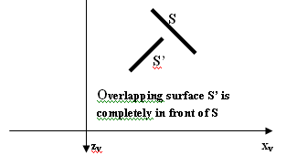
Depth sorting Method
For tests (ii) and (iii),
Perform inside outside polygon test.
Substitute coordinates for all vertices into plane equation for overlapping
surfaces and check the sign of the result obtained.
Based on plane equation if all vertices of S are inside S’ then S is completely behind S’.
Similarly, S’ is completely in-front of S if all vertices of S are outside of S’.

Slide 43
AREA-SUBDIVISION METHODS
This technique for hidden-surface removal is essentially an image-space method, but object-space operations can be used to accomplish depth ordering of surfaces.
The area-subdivision method takes advantage of area coherence (consistency) in a scene by locating those view areas that represent part of a single surface.
This method is applied successively by dividing the total viewing area into smaller and smaller rectangles until each small area is the projection of part of n single visible surface or no surface at all.
To implement this method, tests need to establish that can quickly identify the area as part of a single surface or show that the area is too complex to analyze easily.

Slide 44
AREA-SUBDIVISION METHODS
Starting with the total view, apply the tests to determine whether subdivision of the total area must be done into smaller rectangles.
If the tests indicate that the view is sufficiently complex, subdivide it.
Next, apply the tests to each of the smaller areas, subdividing these if the tests indicate that visibility of a single surface is still uncertain.
Continue this process until the subdivisions are easily analyzed as belonging to a single surface or until they are reduced to the size of a single pixel.
An easy way to do this is to successively divide the area into four equal parts at each step.

Slide 45
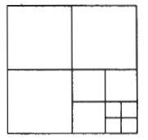
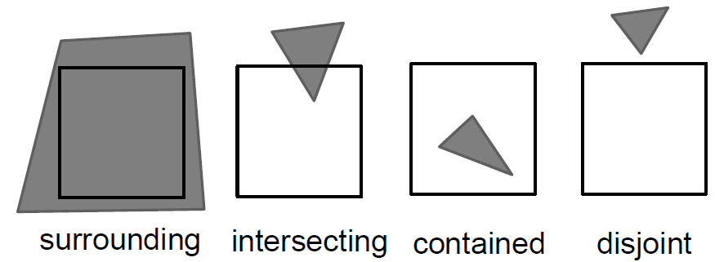
AREA-SUBDIVISION METHODS
Four possible relationships of a surface with a specified area boundary.
Relative surface characteristics:
- Surrounding surface-One that completely encloses the area.
- Overlapping surface-One that is partly inside and partly outside the area.
- Inside surface-One that is completely inside the area.
- Outside surface-One that is completely outside the area.
No further subdivisions of a specified area are needed if one of the following conditions is true:
1. All surfaces are outside surfaces with respect to the area.
2. Only one inside, overlapping, or surrounding surface is in the area.
3. A surrounding surface obscures all other surfaces within the area boundaries.

Slide 46
AREA-SUBDIVISION METHODS
Test 1 : Carried out by checking the bounding rectangles of all surfaces against the area boundaries.
Test 2 : Uses the bounding rectangles in the xy plane to identify an inside surface. Once a single inside, overlapping, or surrounding surface has been identified, its pixel intensities are transferred to the appropriate area within the frame buffer.
Test 3 : Order surfaces according to their minimum depth from the view plane.
For each surrounding surface, then compute the maximum depth within the area under consideration. If the maximum depth of one of these surrounding surfaces is closer to the view plane than the minimum depth of all other surfaces within the area, test 3 is satisfied.
Or use plane equations to calculate depth values at the four vertices of the area for all surrounding, overlapping, and inside surfaces,
If the calculated depths for one of the surrounding surfaces is less than the calculated depths for all other surfaces, test 3 is true. Then the area can be filled with the intensity values of the surrounding surface.

Slide 47
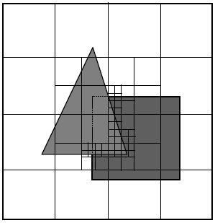
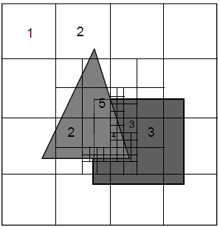
AREA-SUBDIVISION METHODS

Slide 48
Back face culling
i j k
-1 1 0
-1 0 1

Slide 49
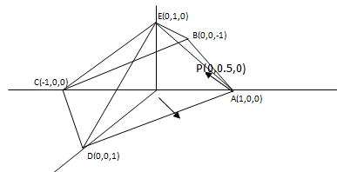
Back face culling
d
Removes faces in the back of an object away from the viewer.
Compute the outward normal to face AED in the rectangular pyramid
The normal is found by the cross product of vectors
AE = -i + j AD = -i + k
n = AE x AD =
= i + j + k
Choosing a point inside the pyramid P(0,0.5,0)
The AP vector is AP = -i + 0.5 j
The dot product of this vector and the normal will indicate the normal orientation:
n. AP = (i + j + k) . (-i + 0.5 j)
= 1 * -1 + 1 * 0.5 = -1 + 0.5 = - 0.5
Since this value is negative the normal is pointing outward hence is a invisible or backface
i j k
-1 1 0
-1 0 1

Slide 50
AREA-SUBDIVISION METHODS
Back face culling
Removes faces in the back of an object away from the viewer.
Compute the outward normal to face AED in the rectangular pyramid
The normal is found by the cross product of vectors
AE = -i + j AD = -i + k
n = AE x AD =
= i + j + k
If the vector V is established from the view point P(5,5,5) to a point in AED such as point A (1,0,0)
Then V = 4i + 5j + 5k
The dot product of n and V is
n.V =(1)(4) +(1)(5) + (1)(5) = 14
since n.V is greater than 0 the face AED is visible.
i j k
-1 1 0
-1 0 1

Slide 51
AREA-SUBDIVISION METHODS
If the vector V is established from the view point P(5,5,5) to a point in AED such as point A (1,0,0)
Then V = 4i + 5j + 5k
The dot product of n and V is
n.V =(1)(4) +(1)(5) + (1)(5) = 14
since n.V is greater than 0 the face AED is visible.

